Slide 1
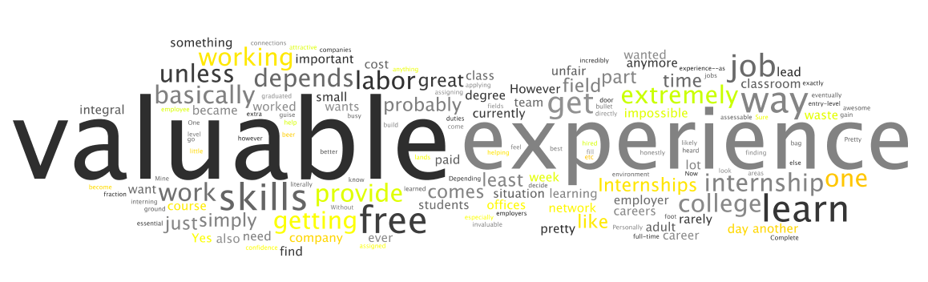
Internship 1
ES 112
N. Shermukhamedova

Slide 2
The Congress of Women of the Kyrgyz Republic

Slide 3

The Congress of Women of the Kyrgyz Republic
CWKR- is a leading local Non Governmental
Organization (NGO)
Mission: Support local women in all spheres
of public life: politics, economy, social aspects.

Slide 4
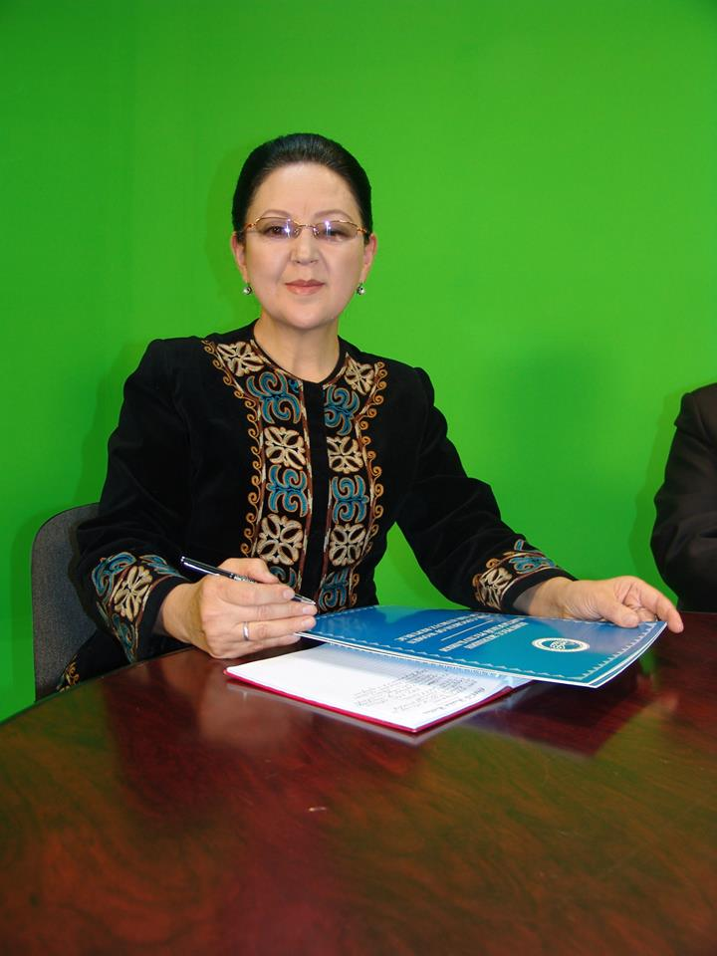
President of the Congress of women of the Kyrgyz Republic:
Akbagysheva Zamira
Akmatyldaevna

Slide 5
My Objectives which I wanted to achieve:
To understand the functioning and working environments of a non-governmental organization
To experience what is like to work in a professional setting
To enhance my communication skills, learn about the organizing and implementing different types of tasks

Slide 6

My Duties During the Internship: Public Relations Assistant.
Writing Emails, copying, faxing
Making calls
Writing official letters, press release
Translating the documents
Organizing
Meetings
Making research

Slide 7
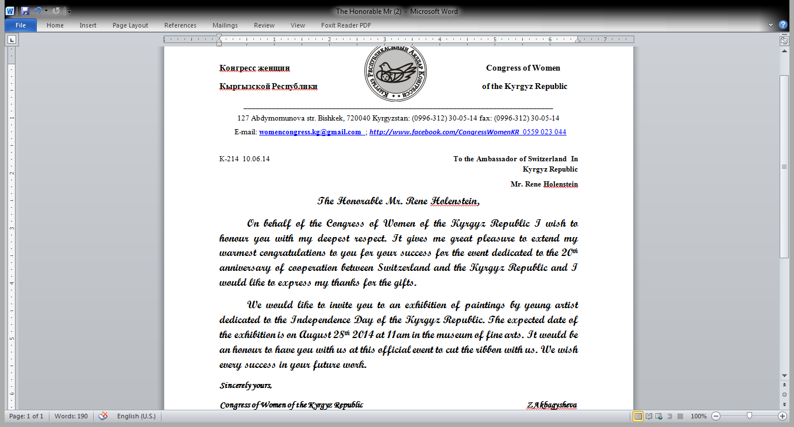
Official Letter of Congratulation:

Slide 8


Learning Outcomes:
Responsible
Flexible
Active
Attentive
Creative

Slide 9


Thanks for your Attention!
http://www.facebook.com/CongressWomenKR
womencongress.kg@gmail.com

